Slide 1
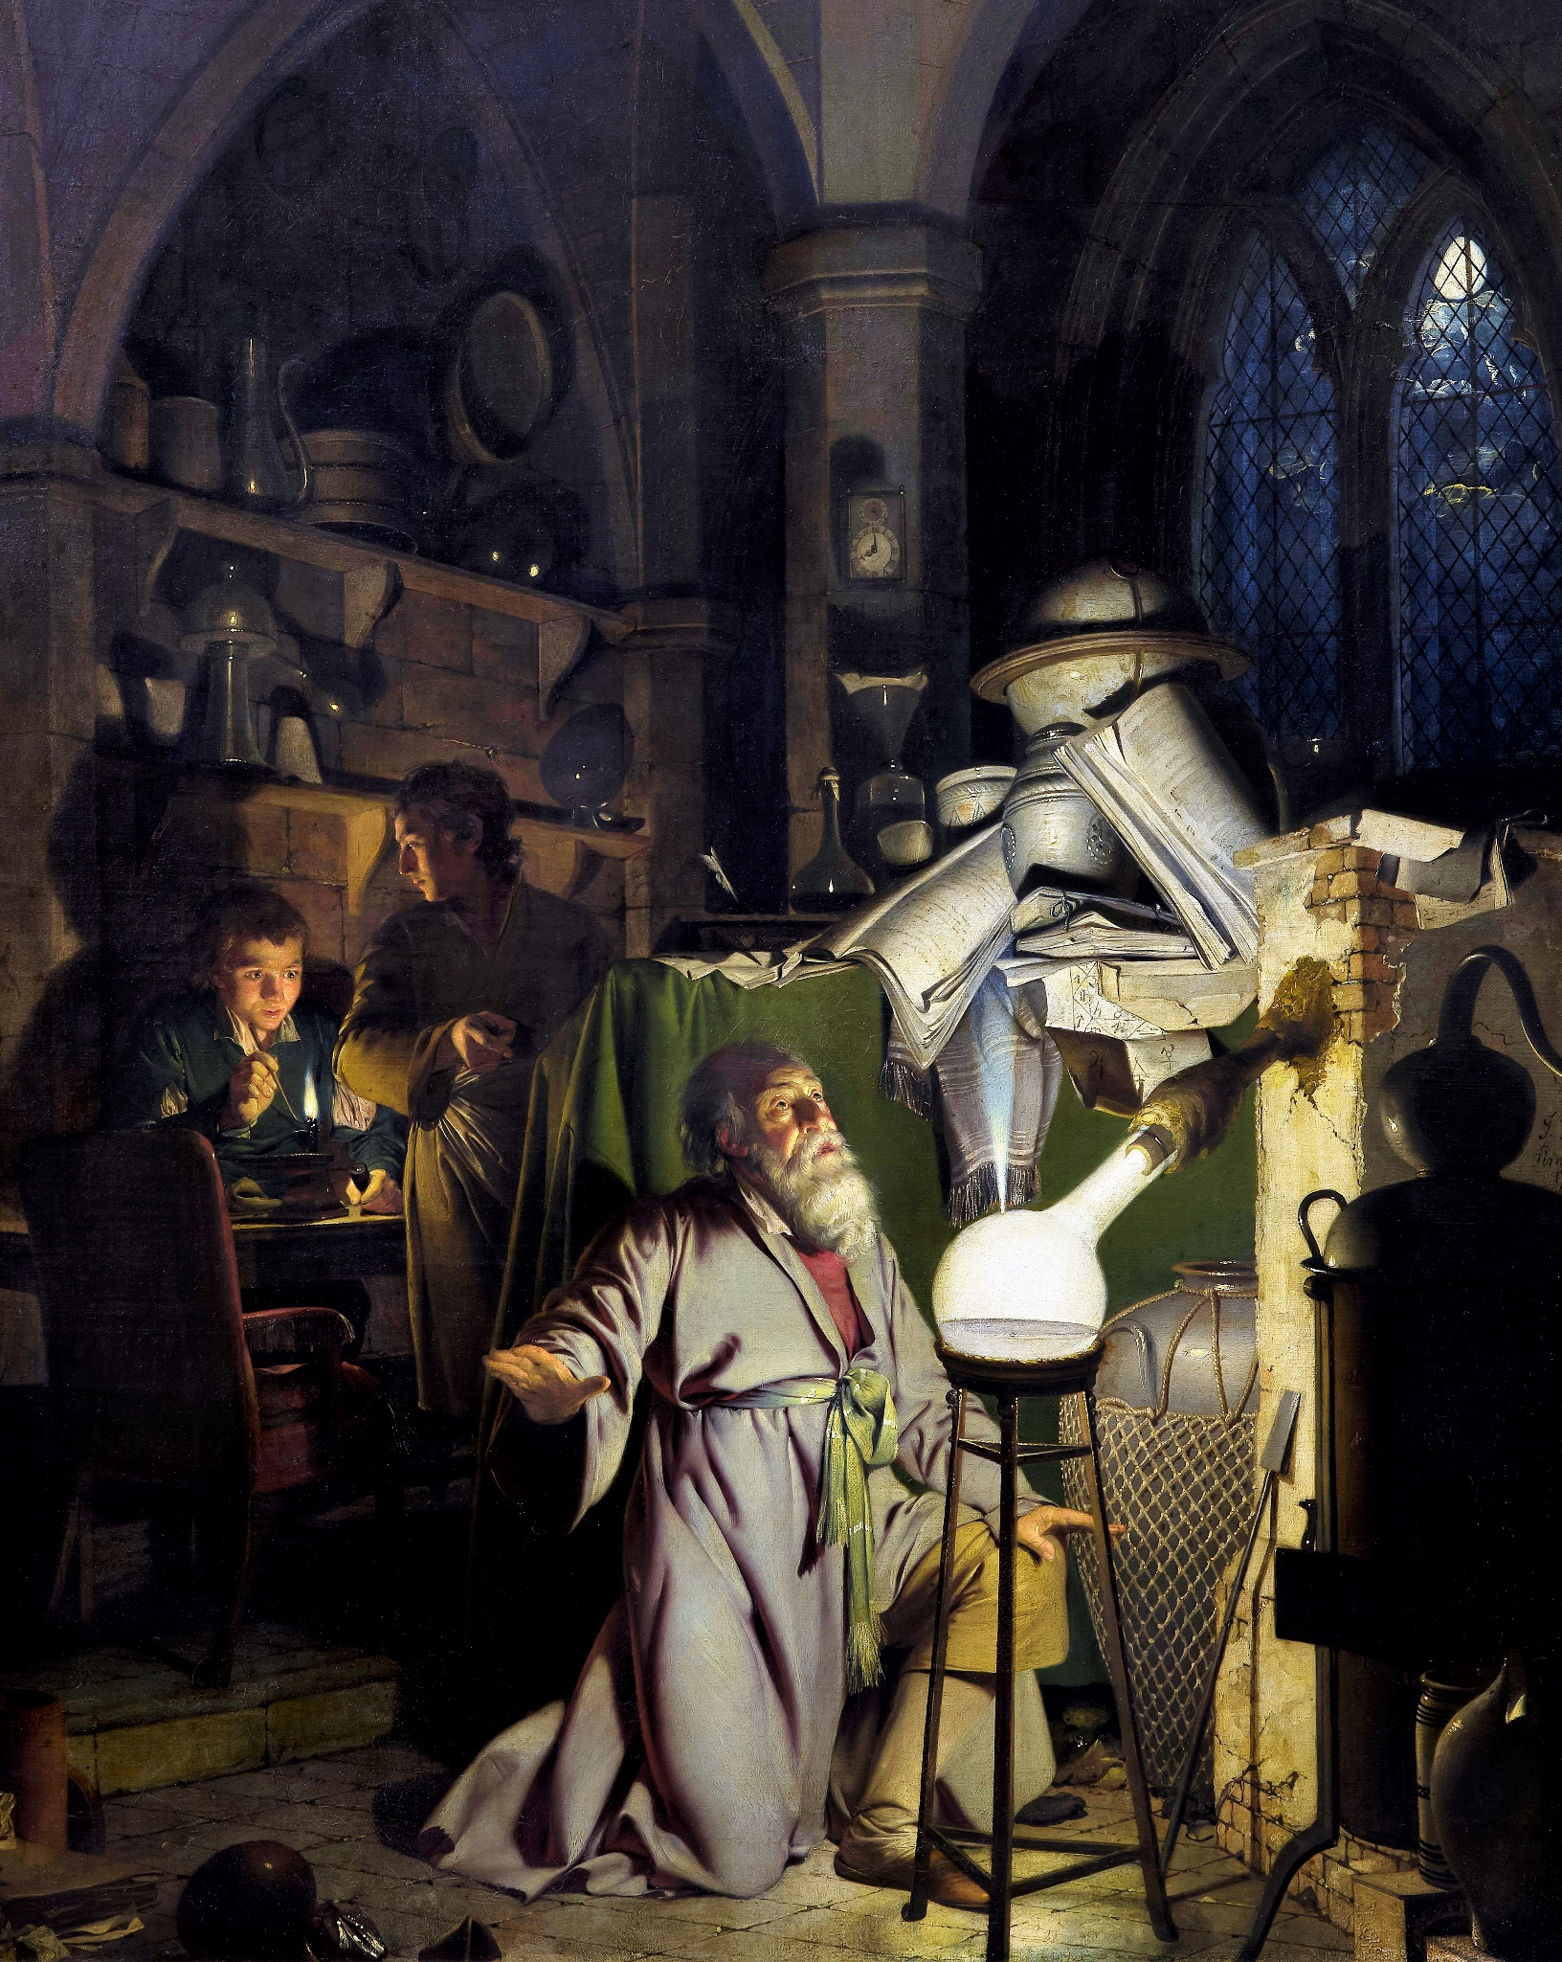

From Building Blocks to Research Processes
IL “Scientific Method and Analysis” WS 25-26
Kami Höferl
(Wright of Derby , Wikimedia, PD)
Notes:
"The Alchemist in Search of the Philosopher’s Stone" by Joseph Wright of Derby (1771)
substance capable of turning base metals such as mercury into gold or silver[
In this work, Wright captures an alchemist conducting an experiment with a crucible in search of the philosopher’s stone. The painting portrays a moment of discovery and highlights the experimental process central to early chemistry, before the formalization of modern science.

Slide 2
Looking Back
Science is … the pursuit and application of knowledge and understanding of the natural and social world following a systematic methodology based on evidence
… a process 👉 „the“ scientific method
quality criteria: Validity, reproducibility, reliability, honesty etc.
… a body of knowledge
… a social institution
It can be conducted disciplinary or interdisciplinary.

Slide 3
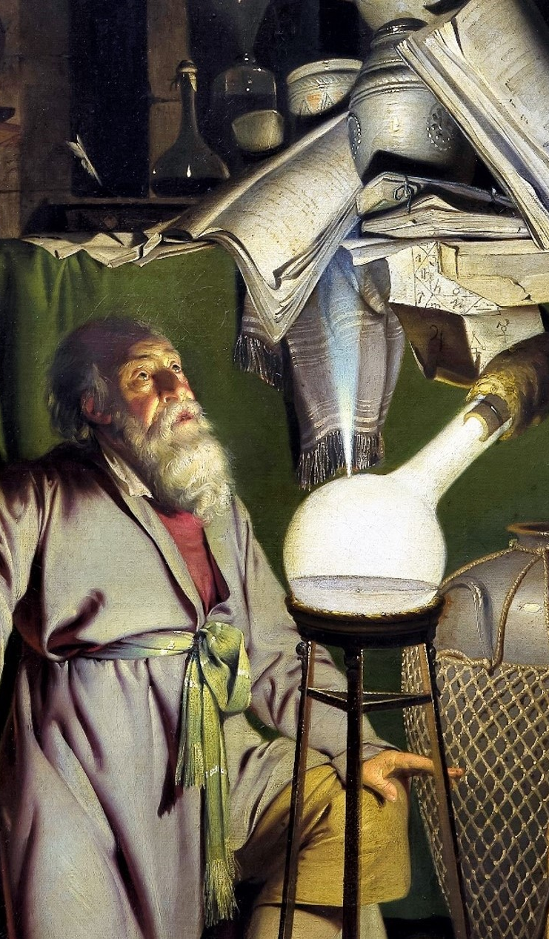
Overview
Building Blocks of Scientific Arguments
The Logic of Logic
Types of Research Processes
Start with Reviewing Literature
Types & where to find them

Slide 4
Some building blocks

Slide 5
A quick catch up:
Science:
has a series of subsystems to make arguments comprehensible, transparent and thus also open to criticism
Consistent use of terms
is not infallible:
Nothing can be considered scientifically proven forever
👉 Scientific results (theories) are created to be replaced by better ones

Slide 6
A statement
Asserted statement
... which can reasonably be said to be either true or false
Information content = depends on possibility of verification
GNP: Migration promotes and/or inhibits the growth of economies
👉 empirically based statements = usually* easily verifiable
Truthfulness
All glaciers are made of ice.
Landslides occur when it rains.
…

Slide 7
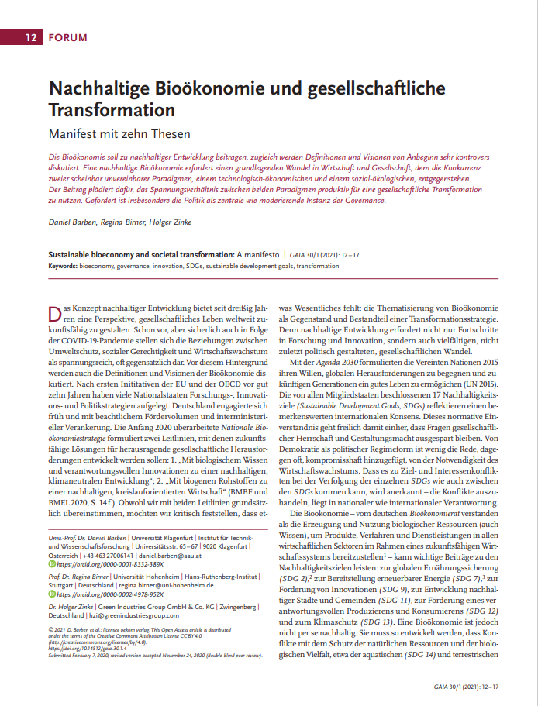
A thesis
Pointed, (controversial) assertions that "require substantiation“:
Refer to facts or statements;
Interpret these;
or imply connections between them.
Often: involve target & transformation knowledge

Slide 8
A hypothesis
"A scientific hypothesis asserts a more or less precise relationship between two or more variables that is supposed to apply to a specific population of comparable objects or events." (Bortz & Döring 2009:8)
“A hypothesis is a formal statement predicting a particular relationship between variables, which can be tested through scientific research.” (Creswell, 2009)
A simple example: If garlic repels fleas, then a dog that is given garlic every day will not get fleas.

Slide 9
Requirements of a hypothesis
If-then structure: 👉 secures testability
If = possibility
Then = expected outcome (👉 predictive power)
Falsifiability: potential to prove it wrong
Parsimony: use the simplest possible explanation
Scope: not just a single instance 👉 population

Slide 10

And finally: A theory
Chapter 2.7 “The importance of theory” from Saunders et al. (2023)

Slide 11
And finally: a theory
Statements on the relative explanatory power of several independent variables & their relationships with each other:
"Theories are assumptions about causal relationships. This means that observable phenomena are related to each other via a theory and brought into a cause-effect relationship“ (Egner 2010:9) 👉 theory = a "system of logically consistent statements about [...]
phenomena" (Atteslander 1984:23)

Slide 12
Requirements for theories
Explicitness: premises, central concepts, assertions, conclusions
Logical consistency: Freedom from contradiction
Substantive and informative: potentially falsifiable
Parsimony: Clarify many findings with as few assumptions as possible
Occam's Razor: the fewer assumptions the better
Proven: must have passed "many" different and "rigorous" tests

Slide 13
Isn’t a hypothesis already a theory?
Aspect | Hypothesis | Theory
Definition | A tentative explanation or prediction that can be tested. | A well-substantiated explanation of phenomena.
Basis | limited evidence or observations. | large body of evidence from repeated tests.
Purpose | guide experiments & investigations. | provide a framework for understanding related facts.
Testability | Must be testable and falsifiable. | Has already been extensively tested and supported.
Scope | Narrow, addressing specific observations or questions. | Broad, addressing a wide range of phenomena.
Status | Preliminary, subject to confirmation or rejection. | Established and widely accepted in the scientific community.
Example | "Plants grow faster in red light than in blue light." | "Evolution by natural selection explains biodiversity."

Slide 14
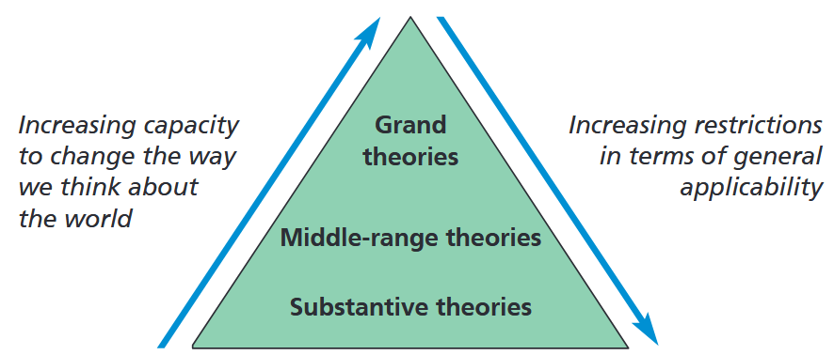
The scope of theories

Slide 15
The scope of theories
Substantive theories:
Empirical regularity:
“Most cars in this road are red" 👉 no explanation of the descriptive statement
Ad hoc theory:
Temporally & spatially limited statement about certain phenomena e.g. Municipal case study on exposure to natural hazards
Middle range theories:
Explanation of phenomena in comparable temporal and spatial contexts e.g. Theories of mountain formation, central place theory etc.
Grand Theories (high complexity/abstraction):
E.g. complexity theories, systems theory according to Luhmann, etc.

Slide 16
The relationship between theories and hypotheses
Theories need (hypo)theses:
Theories of high complexity (e.g. Luhmann's systems theory) = usually not directly empirically testable
👉 Transfer individual aspects of these theories into (hypo)theses & test them empirically

Slide 17
Conclusion on Building Blocks
A statement can be either true or false
A thesis consists of assertions that "require substantiation“
A hypothesis assumes a relationship between two variables
A theory are assumptions about causal relationships between several variables

Slide 18
Logic of logic

Slide 19
Logic?
🤔

Slide 20

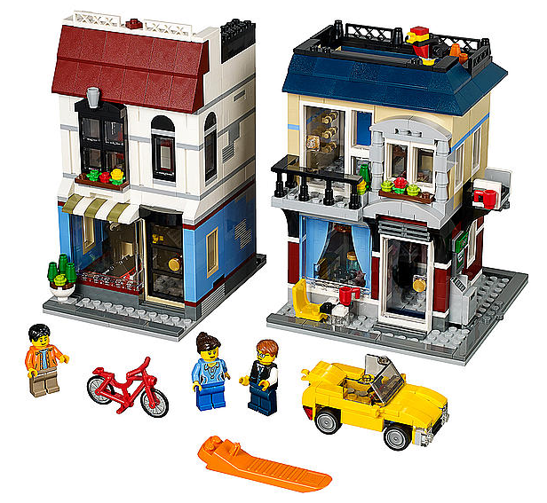
Logical reasoning
Deductive
Hypothesis → Forecast → Comparison with empirical data
Inductive
Empirical observation → Generalisation → Hypothesis
Abductive
Empirical observation → possible explanations → selection of "best" explanation

Slide 21
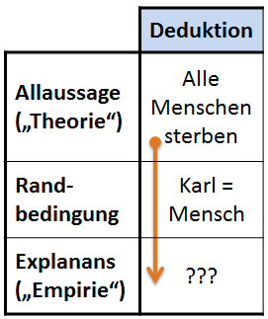
Deductive reasoning
Conclusion from a law to the individual case
Premises + boundary condition = conclusion
Premises: general statement
Boundary condition: Contextual information on scope of argument
"Normal form" (Kuhn 1967) of scientific work
Logically valid ≠ objectively true
Notes:
Boundary: define scope of argument

Slide 22
Deduction in Action
Phenomenon
Hempel-Oppenheim-Scheme:
Popper's approach to the development of a theory or hypothesis
👉 DEDUCTIVE-nomological research perspective
Theory / Hypothesis
Revision Reformulation
Verification of the theory / hypothesis
Falsification not possible
Falsification
Preliminary confirmation of the theory / hypothesis

Slide 23
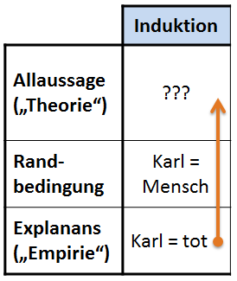
Inductive reasoning
Preconditions for inductive reasoning (Chalmers 2001:38pp.):
Generalisation: large number of observations
Observations: large variety
👉 No observation must refute inductive conclusion
Notes:
Boundary: define scope of argument

Slide 24
Inductive reasoning
Induction does not provide logically valid arguments → "inductive fallacy"
Problem of causality C→E:
Behaviour in the past ≠ Behaviour in the future
Problem of necessary pre-existing knowledge about “It”
👉 Induction cannot provide "new" knowledge
Notes:
Boundary: define scope of argument

Slide 25

@ inductive fallacy

Slide 26
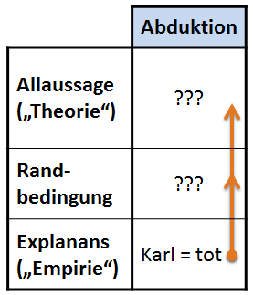
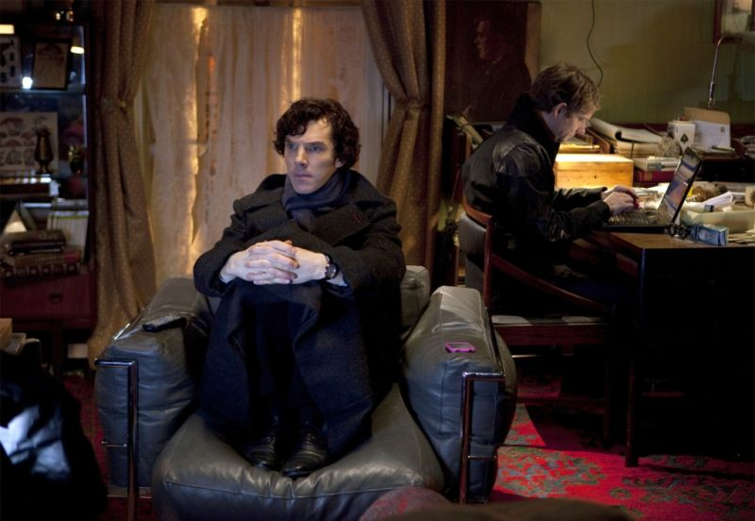
And the combination: Abductive reasoning
Umberto Eco: "detective method“
👉 Discovery of “the new”, the “irrational moment”

Slide 27
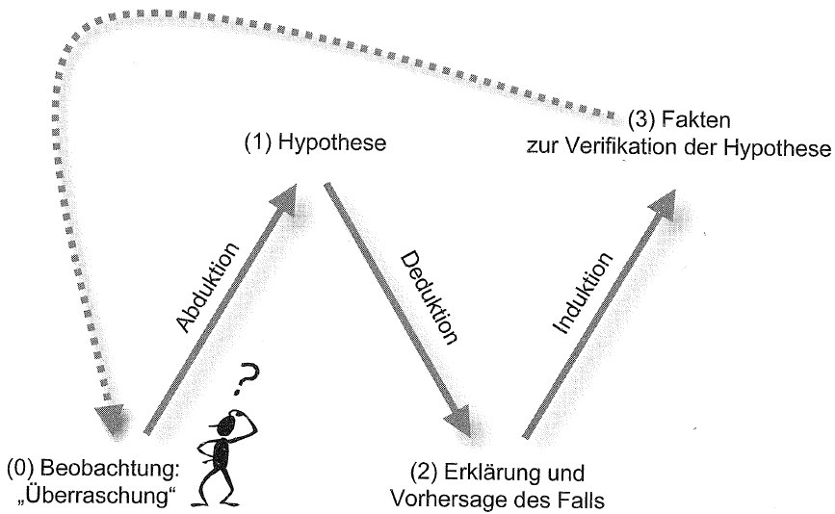
And the combination: Abductive reasoning
Umberto Eco: "detective method“
👉 Discovery of “the new”, the “irrational moment”
Starting point: A surprise
→ Search for a new rule (= hypothesis)
→ Search for further cases that can be explained with the new rule

Slide 28

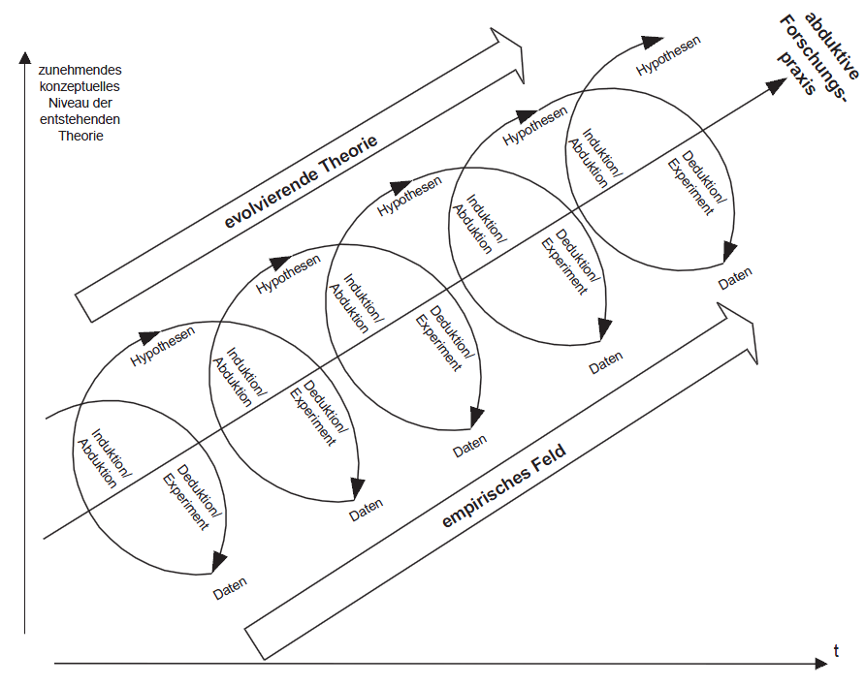
And the combination: Abductive reasoning
Cyclical ("hermeneutic") approach

Slide 29
It depends … what you want to know

Slide 30
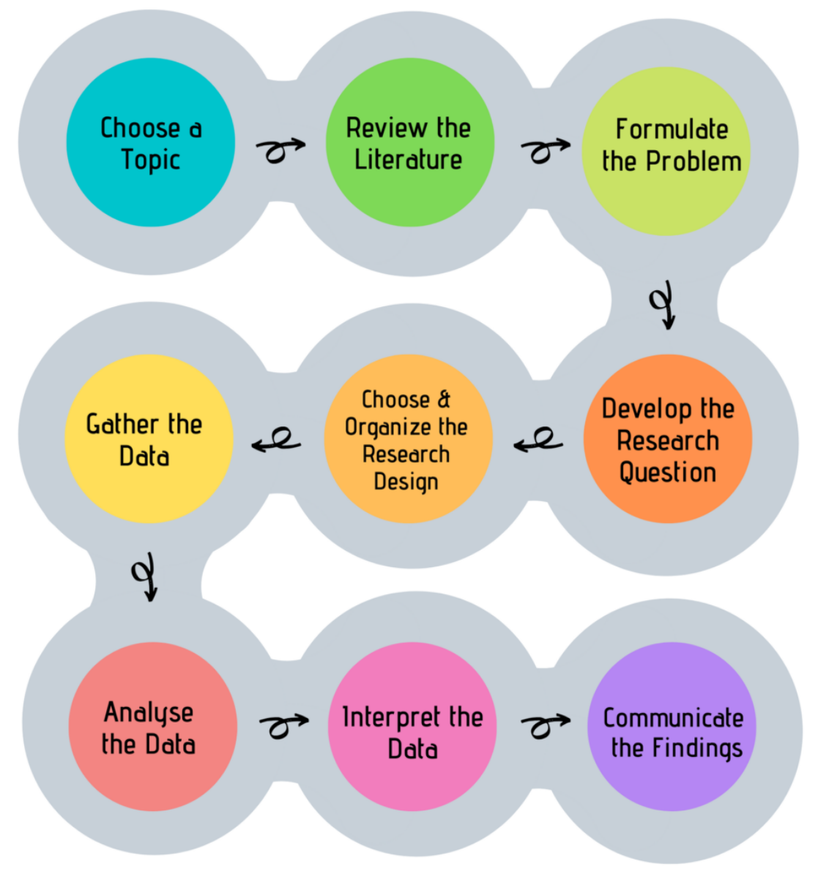
The Problem
Often:
Models of the research process = one size fits all
Hidden assumption:
Evaluate hypothesis in experiment

Slide 31
What else could we want to know?
🤔

Slide 32
What else could we want to know?
Empirical research
Explorative research
Explanatory research
Descriptive research
Prognostic research
Evaluative research

Slide 33
Explorative research
Exploration:
More or less systematic collection of information
not instrumental (= “pretest”) preliminary investigation
👉 Empirical work as a scientific (=reproducible) search for hypotheses

Slide 34
Explorative research
Types of explorative research:
Theory-based exploration:
Reformulation & supplementation of existing theories
Method-based exploration:
methods as a stimulus for new object models
Empirical-quantitative exploration:
from quant. Data 👉 inductively infer to new hypotheses
Empirical-qualitative exploration:
from qual. Data 👉 inductively infer to new hypotheses

Slide 35
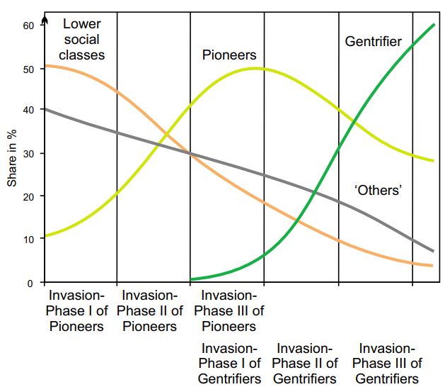
Theory-based exploration: Succession Model of Gentrification

Slide 36
Empirical explorative research
Operationalisation & planning
Hypotheses, Type formation (→ Publication)
Interest
Data collection
Data analysis & Interpretation

Slide 37
Quantitative explorative research
Based on the preparation and presentation of quantitative data
→ unconsidered or undiscovered patterns & regularities
Focus not primarily on data collection
Many variables → graphical & multivariate methods:
Descriptive analyses (classics: socio-demographic characteristics)
Exploratory Data Analysis (EDA)
Multivariate exploration technique

Slide 38
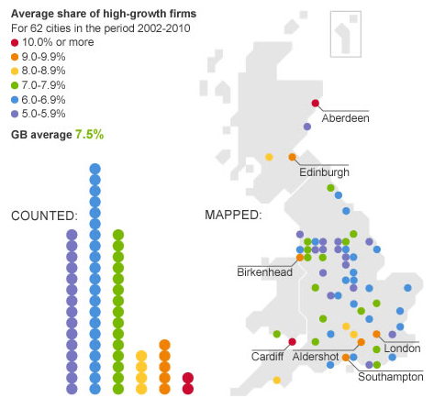
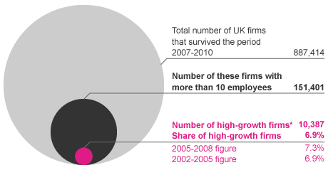
Quantitative explorative research

Slide 39
What else could we want to know?
Empirical research
Explorative research
Explanatory research
Descriptive research
Prognostic research
Evaluative research

Slide 40
Explanatory research
Choose a hypothesis
Operationalisation & planning
Data collection
Publication (Evaluation theory/hypothesis)
Data analysis & interpretation
Interest
Focus:
Evaluate a hypothesis

Slide 41
Explanatory research
Aim: (Statistical) test of assumed Cause-and-Effect relationships (= hypotheses):
Clarify Complex Relationships
Insights into Underlying Mechanism
Difference to descriptive & explorative studies:
Prior knowledge necessary → formulate a testable hypothesis BEFORE the study
"Investigable": Precisely formulated direction of effect & effect size of a hypothesis
→ Ensures testability

Slide 42
Explanatory research
Phenomenon
Hempel-Oppenheim-Scheme:
Popper's approach to the development of a theory or hypothesis
👉 DEDUCTIVE-nomological research perspective
Theory / Hypothesis
Revision Reformulation
Verification of the theory / hypothesis
Falsification not possible
Falsification
Preliminary confirmation of the theory / hypothesis

Slide 43
What else could we want to know?
Empirical research
Explorative research
Explanatory research
Descriptive research
Prognostic research
Evaluative research

Slide 44
Descriptive Research
Selection investigation object
Operationalisation & planning
Data collection
Formal description & Interpretation
Exploration
Descriptive data analysis
Interest
Focus:
Describe object or process

Slide 45
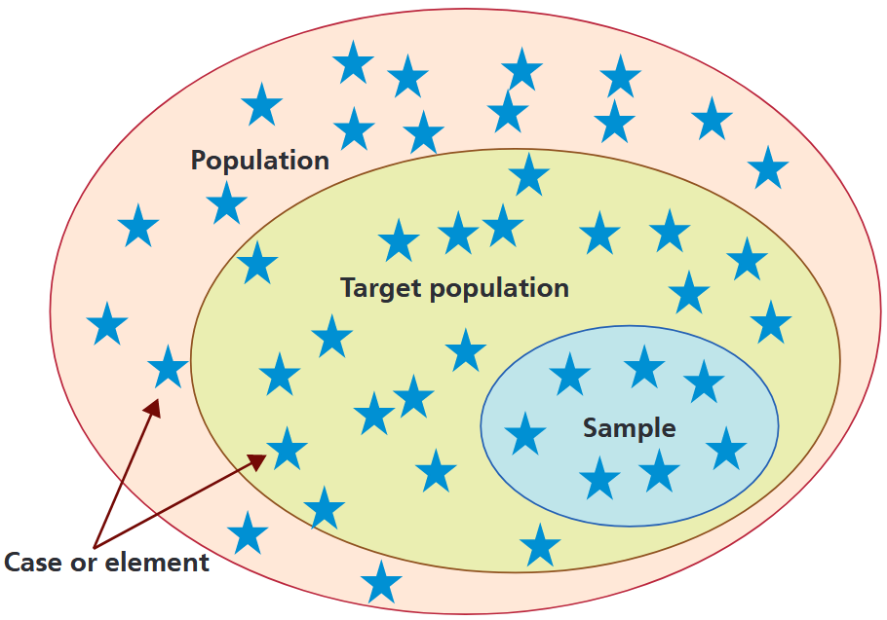
Descriptive research
Objective: Information on the characteristics and distribution of features in populations
Usually no survey of the population possible:
Population is (practically) infinite (e.g. newspapers)
Population is sometimes (at best) partially known (e.g. drug addiction, fare dodgers, etc.)
Investigation would affect the population too much (e.g. quality controls)
Investigation of the population is too time-consuming
→ Survey of samples

Slide 46
The Problem … solved
Often:
Models of the research process = one size fits all
Hidden assumption:
Evaluate hypothesis in experiment
👉 Research processes can follow different (cognitive) goals

Slide 47
Let’s get started

Slide 48
Another look at the research process

Slide 49
Step 1: Choos a topic
Ideal:
Based on your interests
Based on a peers recommendation
👉 If you are not sure: Talk to your peers & lecturers
Not so ideal:
Because of funding

Slide 50
Another look at the research process

Slide 51
Step 2: Review the literature
🤔

Slide 52
When Conducting own Empirical Research
Become familiar with a field of research.
Provide a context for your research.
Justify the research you are proposing.
Ensure that your proposed research has not been carried out by another person (and if you find it has, then your literature review should specify why replication is necessary).
Show where your proposed research fits into the existing body of knowledge.
Enable the researcher to learn from previous theories on the subject.
Illustrate how the subject has been studied previously.
Highlight flaws in previous research.
Outline gaps in previous research.
Show how your proposed research can add to the understanding and knowledge of the field.
Help refine, refocus, or even move the topic in a new direction.

Slide 53
But where is “the” knowledge?
Fields of scientific knowledge:
Causal explanations & descriptions of phenomena*
Foundational Concepts and Theories
Eg. Laws of Thermodynamics
Research Methodologies
Qualitative & quantitative Methods
Scientific Processes
Formation of questions & hypothesis
Experimentation
Data analysis
Peer review
Ethics & standards

Slide 54
Here:
Sum of all formal outcomes:
Academic Publications: Peer-reviewed journals, monographs
Conferences: Oral presentations, posters, workshops
Digital Repositories: Institutional & subject-specific platforms (ResearchGate, Zenodo, arXiv etc.)
General Publications: Books, magazines, popular science
Media & Press: Press releases, science journalism, radio/TV
Public Engagement: Lectures, science fairs, outreach workshops
Education: University courses, online courses, science kits
Social Media: Blogs, Videos, podcasts
Policy Briefs: Summaries for policymakers, white papers
Industry & Non-Profits: Applied research partnerships, NGO reports

Slide 55
White vs. grey literature
Here’s a comparison of the characteristics of white and grey academic literature:
Key Takeaway:
White Literature: Rigorous, peer-reviewed, and academic in nature, best for theoretical and empirical research.
Grey Literature: Practical, timely, and less formal, often addressing niche or emerging issues. It is valuable but requires careful evaluation for credibility.
White Literature:
Academic, formal
peer-reviewed / editorial standards
Grey Literature:
Practical, timely & less formal
addressing niche or emerging issues
👉 careful evaluation for credibility

Slide 56
White vs. grey literature
Here’s a comparison of the characteristics of white and grey academic literature:
Key Takeaway:
White Literature: Rigorous, peer-reviewed, and academic in nature, best for theoretical and empirical research.
Grey Literature: Practical, timely, and less formal, often addressing niche or emerging issues. It is valuable but requires careful evaluation for credibility.
Aspect | White Academic Literature | Grey Academic Literature
Definition | Peer-reviewed, formally published academic work. | Research or reports not formally published or peer-reviewed.
Examples | Journal articles, books, conference papers. | Technical reports, theses, white papers, policy briefs.
Publication Process | Strict peer-review and editorial standards. | Limited or no peer review; may be self-published.
Accessibility | Typically available through academic journals or libraries. | Often harder to access; found in institutional repositories or online.
Credibility | High, as it undergoes rigorous quality control. | Varied; credibility depends on the source and authorship.
Intended Audience | Academics, researchers, and experts in the field. | Policymakers, practitioners, or niche audiences.
Timeliness | Slower to publish due to rigorous review. | Often more current, providing recent or emerging findings.
Citations | Highly cited in scholarly works. | Less frequently cited, but influential in specific contexts (e.g., policy).
Scope | Focused on theoretical, experimental, or empirical studies. | Practical, technical, or policy-oriented studies.
Permanence | Archival and widely distributed. | May lack long-term archiving and be difficult to locate over time.

Slide 57
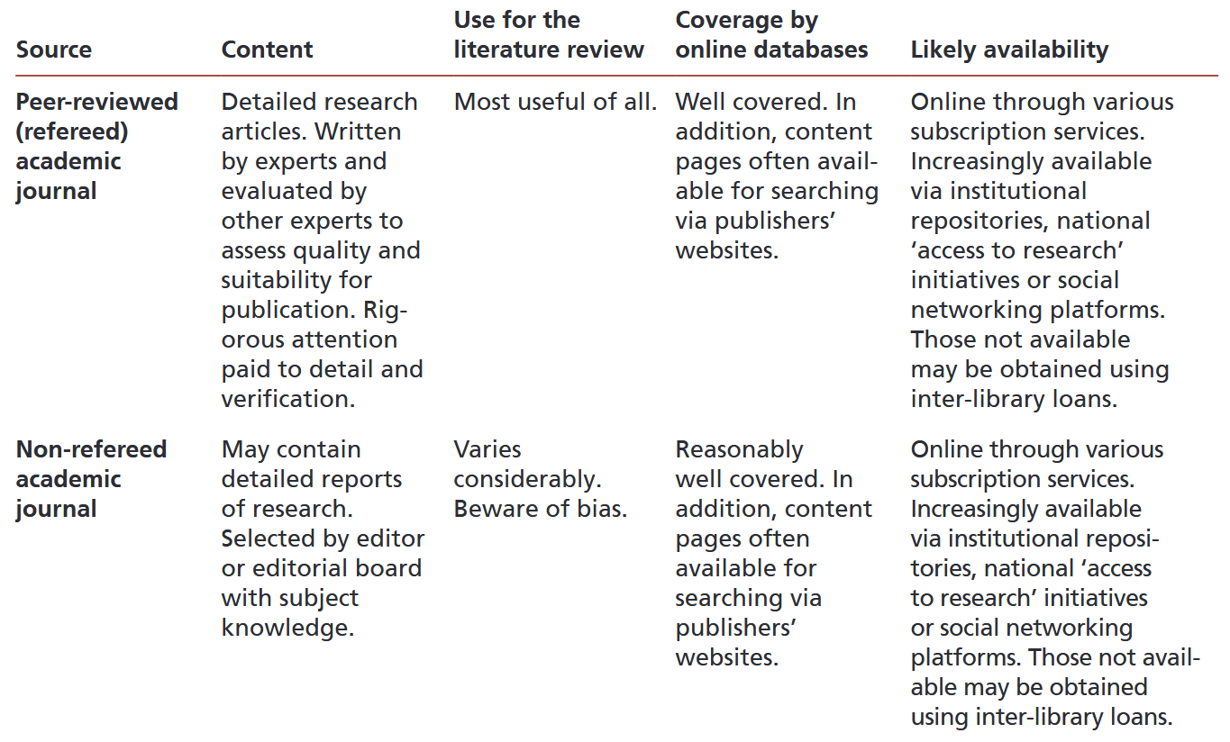
What literature is there?

Slide 58
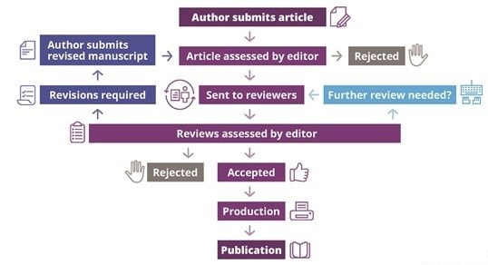
Peer review?

Slide 59
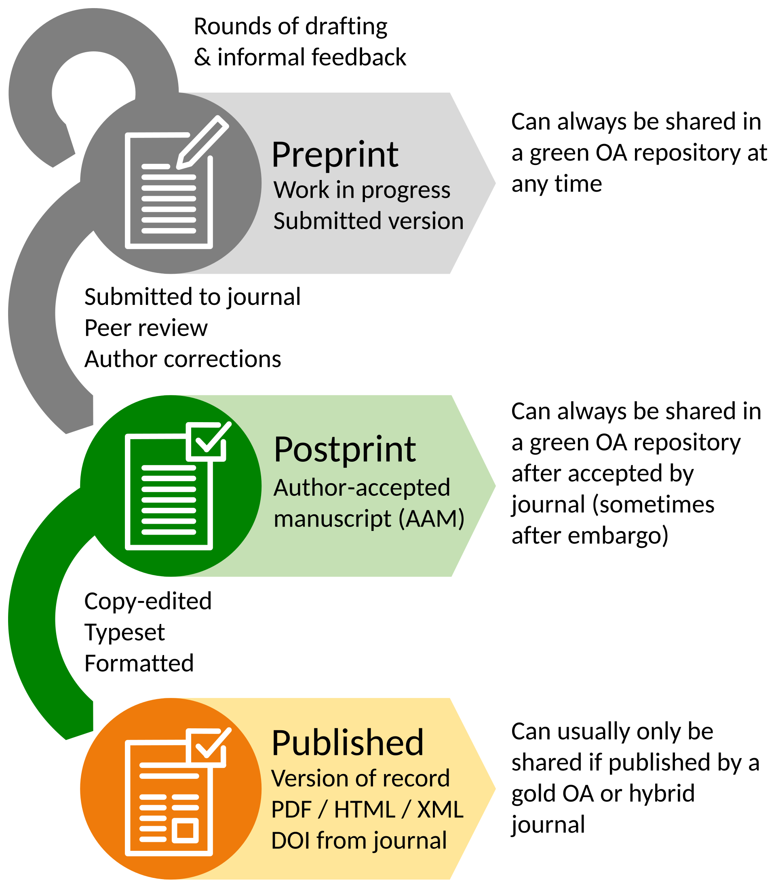



The before & after peer review

Slide 60
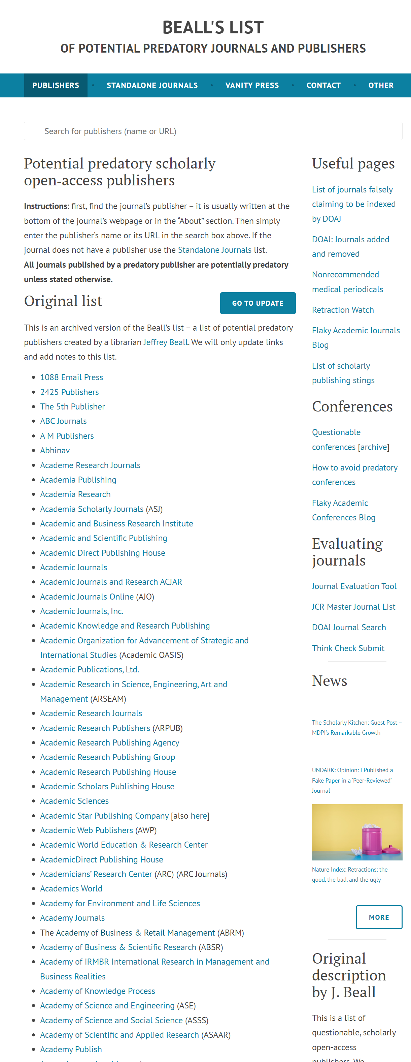
Beware: Predatory journals
deceptive publications that exploit researchers by charging high fees for publishing without providing legitimate editorial and peer-review processes

Slide 61
Another layer of complexity: Open/Closed Access
Aspect | Open Access | Closed Access
Access | Free to read for everyone online. | Requires a subscription or pay-per-view access.
Cost for Authors | Authors often pay Article Processing Charges (APCs). | No direct cost for authors; costs covered by subscriptions.
Audience Reach | Accessible to the public and researchers globally. | Limited to subscribers, institutions, or paywall access.
Visibility | High; easily discoverable and shareable. | Restricted; limited audience and accessibility.
Speed of Dissemination | Often faster publication due to online-first focus. | Slower, as access is tied to subscription releases.
Examples | PLOS ONE, BioMed Central. | Elsevier’s subscription journals, Wiley, Springer.
Funding Sources | Author fees, institutional support, or public grants. | Subscription revenue from individuals or libraries.
Ethical Aspect | Promotes equitable access to knowledge. | Knowledge access is restricted by economic barriers.

Slide 62
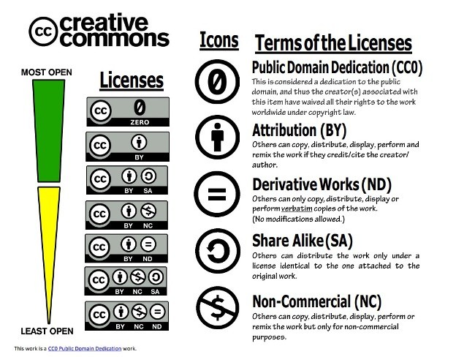
Open Access: All about licences

Slide 63
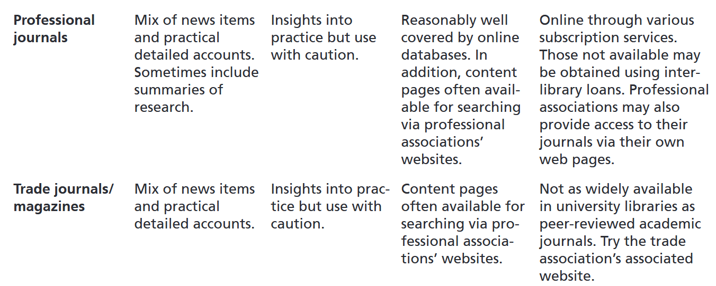
What literature is there?

Slide 64
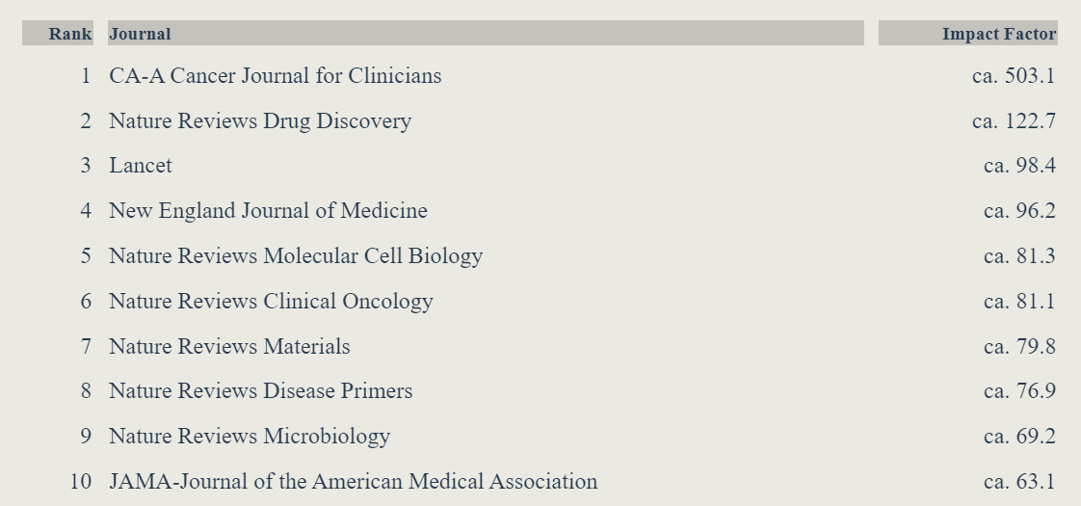
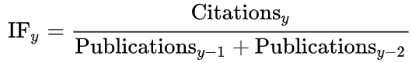
What is a “good” journal?
Impact Factor(IF)*:
“reflects the yearly mean number of citations of articles published in the last two years in a given journal, as indexed by Clarivate's Web of Science.” (Wikipedia, 2024)

Slide 65
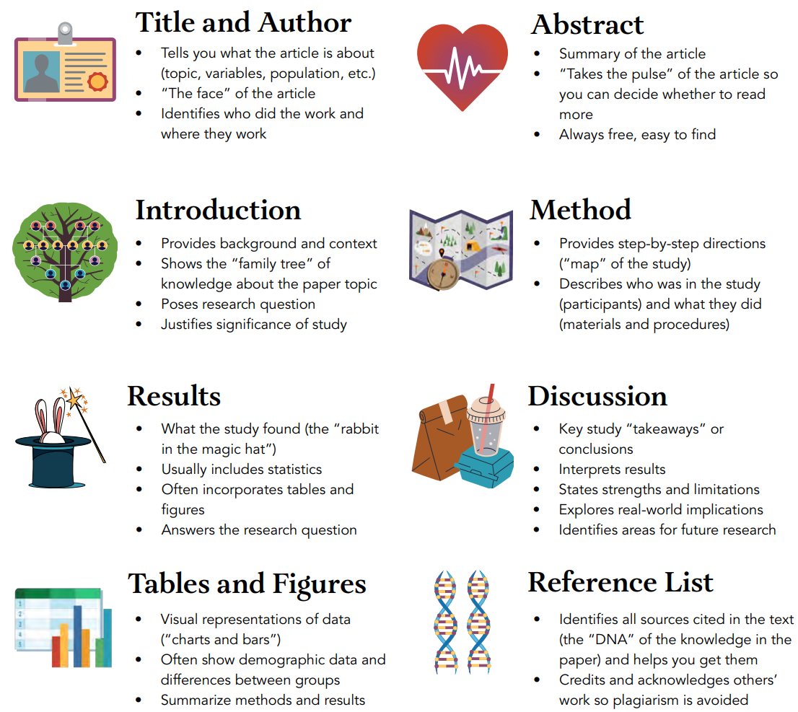
Structure of a “good” journal article

Slide 66
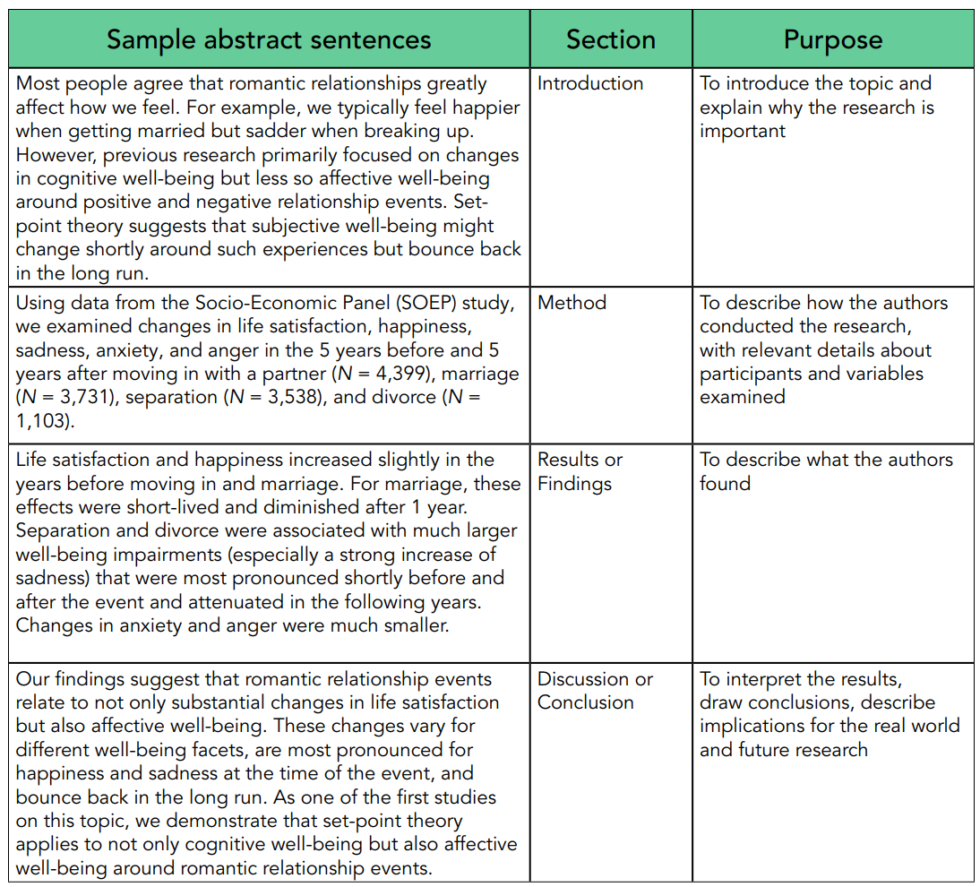
Most important: The abstract

Slide 67
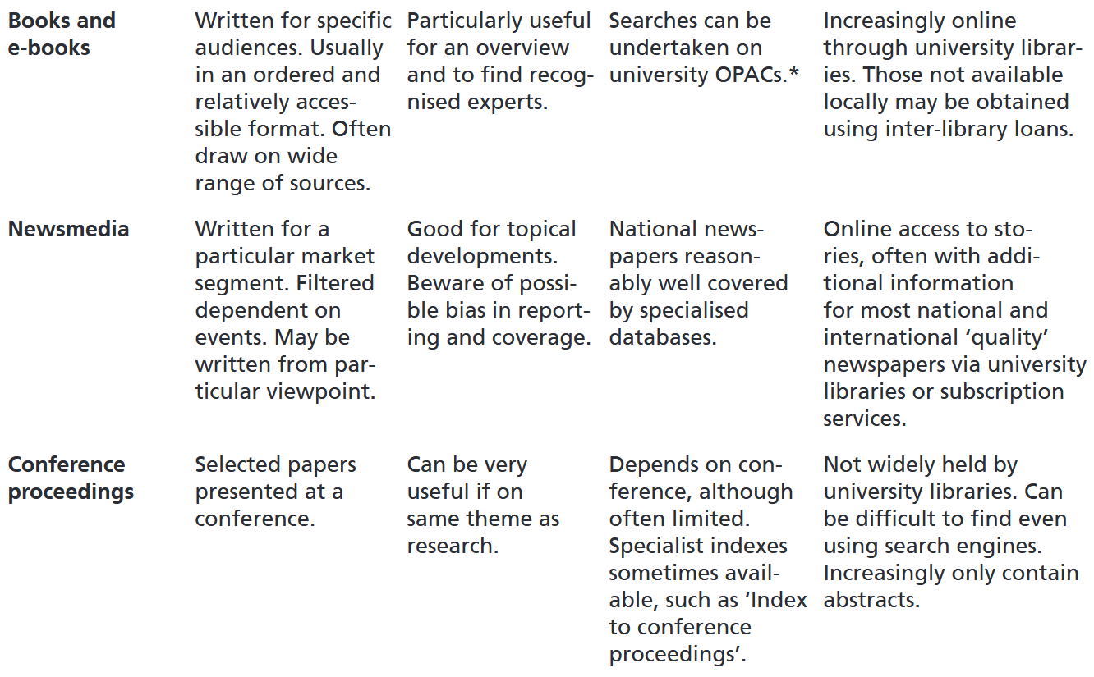
What literature is there?

Slide 68
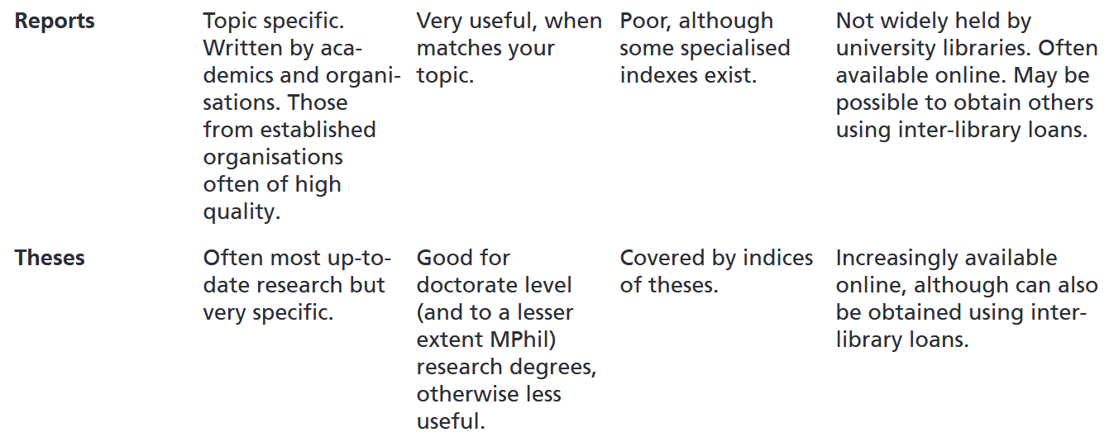
What literature is there?

Slide 69
What literature is there?

Slide 70
Here:
Sum of all formal outcomes:
Academic Publications: Peer-reviewed journals, monographs
Conferences: Oral presentations, posters, workshops
Digital Repositories: Institutional & subject-specific platforms (ResearchGate, Zenodo, arXiv etc.)
General Publications: Books, magazines, popular science
Media & Press: Press releases, science journalism, radio/TV
Public Engagement: Lectures, science fairs, outreach workshops
Education: University courses, online courses, science kits
Social Media: Blogs, Videos, podcasts
Policy Briefs: Summaries for policymakers, white papers
Industry & Non-Profits: Applied research partnerships, NGO reports

Slide 71
How 2 find literature & data

Slide 72
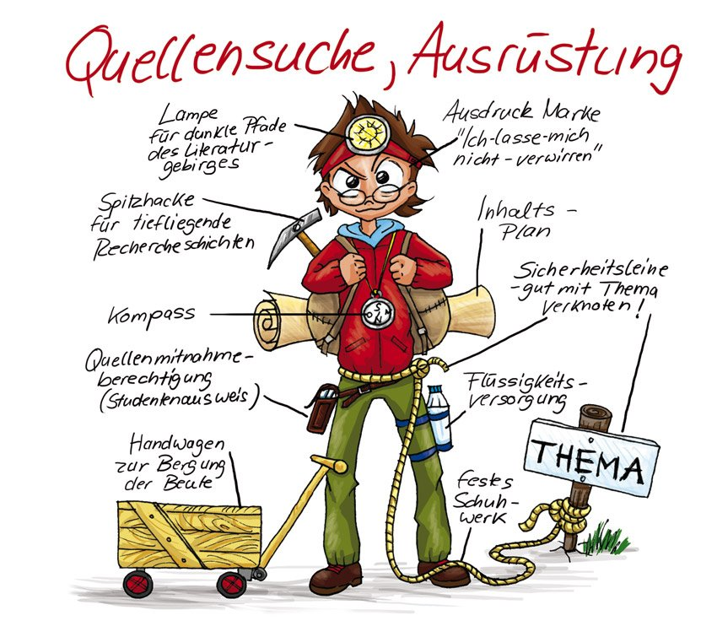
Well …

Slide 73

Well …

Slide 74
Well …
Old school: Search on the shelf
Electronic catalogues:
IMC:
PRIMO: https://search-duk.obvsg.at/
Österr. Bibliothekenverbund: http://search.obvsg.at/OBV
Worldwide:
Karlsruher Virtueller Katalog: https://kvk.bibliothek.kit.edu/
Worldcat: http://www.worldcat.org/
Interlibrary loans:
IMC: https://www.donau-uni.ac.at/de/universitaet/service/bibliothek/ressourcenbestellung.html
Google Books / Scholar
http://books.google.com / https://scholar.google.at

Slide 75
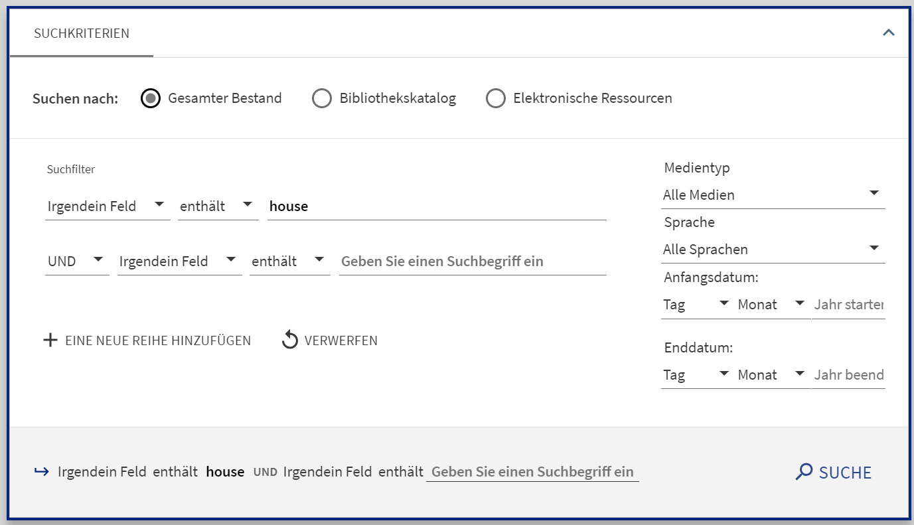
Digression: Talking to computers
and = intersection
Hits that contain both term A and term B
or = common set
Hits that contain either term A or term B
and not = exclusion set
Hits that contain term A but not term B
→ "()" for nesting search arguments
→ "*" as a placeholder

Slide 76
Meta-portals of big publishers
Elsevier „ScienceDirect“: http://www.sciencedirect.com/
Springer „SpringerLink“: http://www.springerlink.com/
Taylor and Francis: http://www.tandfonline.com/
Emerald: https://www.emerald.com/insight/

Slide 77
Do we have this journal?
Local:
Elektronische Zeitschriftenbibliothek (EZB) https://ezb.uni-regensburg.de/?bibid=DUK
Austria-wide:
Österreichischer Bibliothekenverbund – Teilkatalog Zeitschriften und Serien: http://opac.obvsg.at/acczs

Slide 78
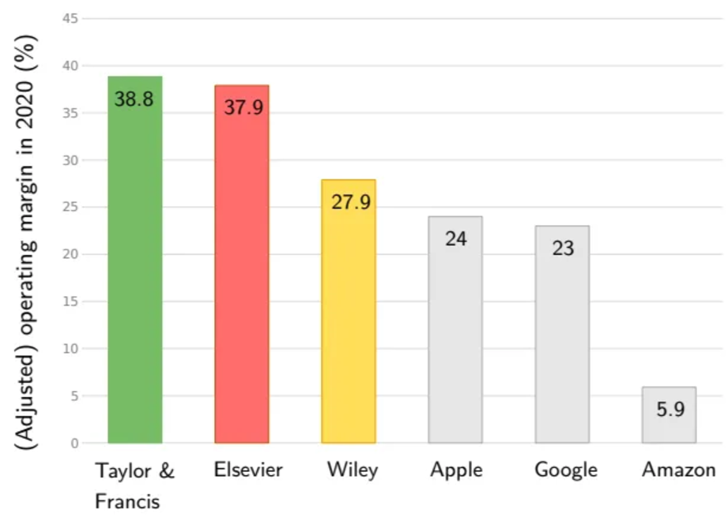
Digression: Closed & open access?
Closed Access:
Research articles = available only to subscribers or institutions that pay for access
👉 limiting public availability
Open Access:
Research articles = freely available to anyone online
👉 wider dissemination & accessibility without paywalls
Notes:
Elsevier: 2023 adjusted operating profit of £3 billion (3,5 billion)

Slide 79
Commercial academic search services
ISI Knowledge: http://www.isiknowledge.com
JSTOR – Archive: http://www.jstor.org/
Google Scholar: http://scholar.google.com
Ai based search engines:
Science.os: https://www.scienceos.ai/
Consensus: https://consensus.app/
…

Slide 80
Academic repositories
General purpose repositories:
arXiv: https://arxiv.org/
Zenodo: https://zenodo.org/
Disciplinary repositories:
Social Sciences Research Network (SSRN): https://papers.ssrn.com/
bioRxiv: https://www.biorxiv.org/
ECONSTOR: https://www.econstor.eu/
Institutional repositories:
University of Vienna: https://uscholar.univie.ac.at/
…

Slide 81
Do not rush into searching
Depending on your pre-exiting knowledge:
0 to little:
Find a textbook on the topic
Follow up on referenced authors, methods, theories, etc.
Medium to pro: 👉 boundaries of your search
Subject area
Authors & institutions
Type of literature
Time frame
Geograhical and/or historical scope
Language
Warm-up with review articles!

Slide 82
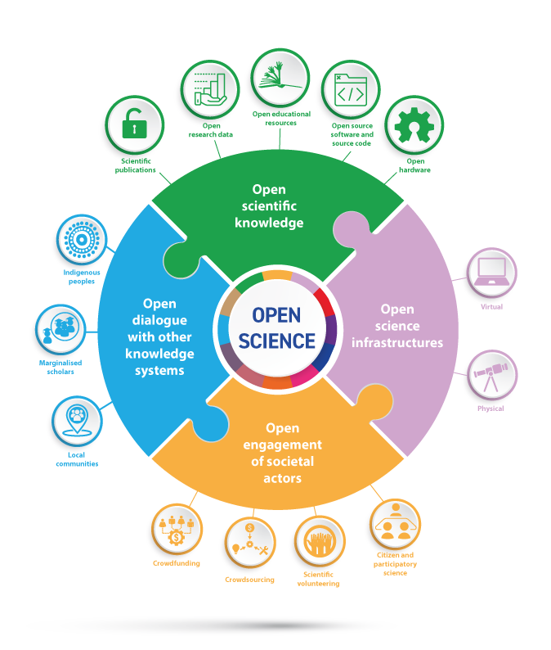
Not just literature …
👉 Data
Software
Code
Hardware

Slide 83
Finding data
Österreich:
Open Data: https://www.data.gv.at
Statistik Austria: http://www.statistik.at
Geodaten: http://www.geoland.at
Südtirol - ASTAT: http://www.provinz.bz.it/astat/de
Deutschland - Statistisches Bundesamt : http://www.destatis.de/
Schweiz – Bundesamt für Statistik: www.bfs.admin.ch

Slide 84
Finding data
GESIS - Leibniz-Institut für Sozialwissenschaften: https://www.gesis.org/home/
FAO - Food and Agriculture Organisation: http://faostat.fao.org
UNDP: Human Development Reports: http://hdr.undp.org/en/statistics
Weltbank - Data & Statistics: http://www.worldbank.org/data
CIA - The World Factbook: https://www.cia.gov/the-world-factbook/
WTO - International trade and tariff data: http://www.wto.org/english/res_e/statis_e/statis_e.htm
EM-DAT - Emergency Events Database: http://www.emdat.be

Slide 85
Wrap it up

Slide 86
Till next session:
Chapters 3.1 & 3.5 on critically reviewing the literature from Saunders et al. (2023)

Slide 87
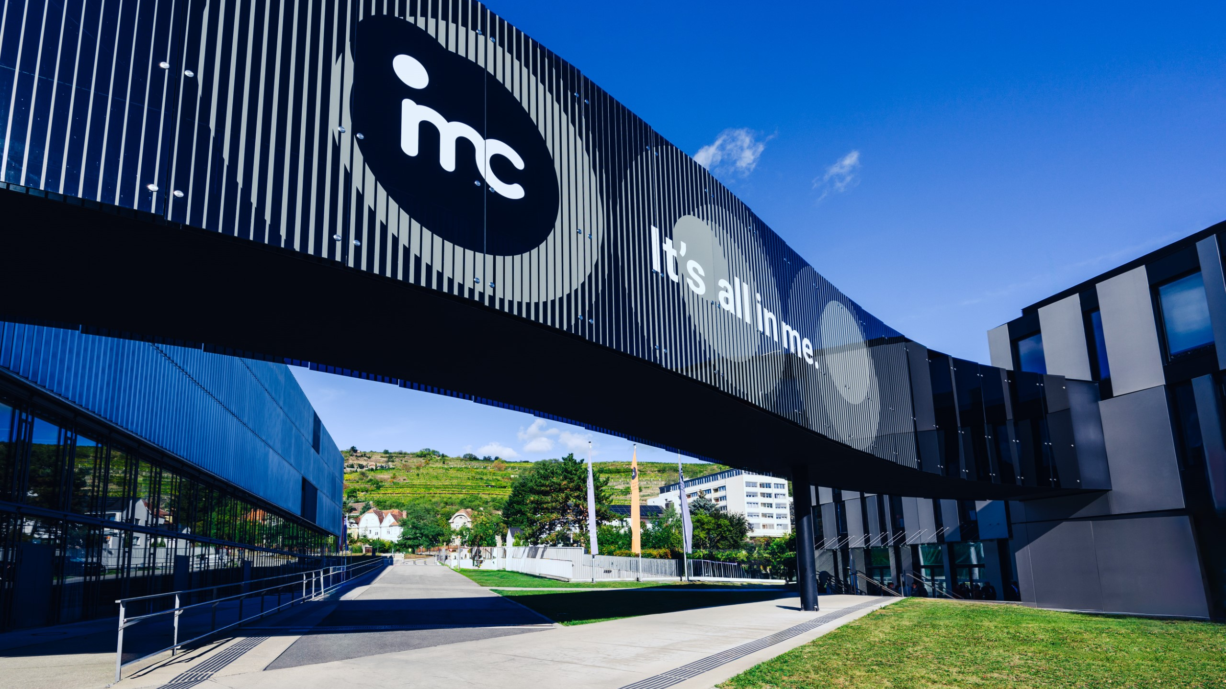
So long & cheerio!

